Slide 1

LENZ’S LAW

Slide 2
CONTENT
Magnetic Field
Induction
Faraday’s Laws
Lenz’s Law
Right Hand Rule
Direction of induced Current
Examples
Applications Of Lenz’s Law

Slide 3
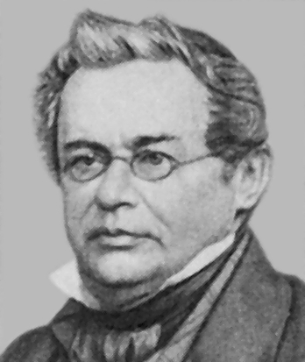
Russian physicist
(1804-1865)
1834 Lenz’s Law
There is an induced current in a closed conducting loop if and only if the magnetic flux through the loop is changing. The direction of the induced current is such that the induced magnetic field always opposes the change in the flux.

Slide 4
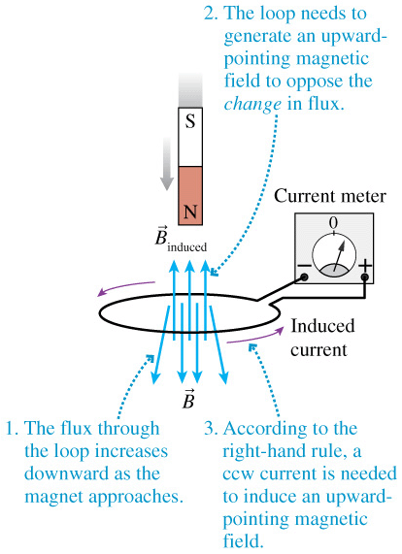
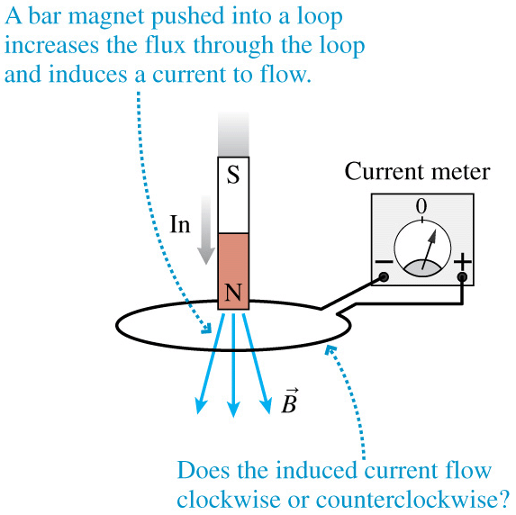
There is an induced current in a closed conducting loop if and only if the magnetic flux through the loop is changing. The direction of the induced current is such that the induced magnetic field always opposes the change in the flux.

Slide 5
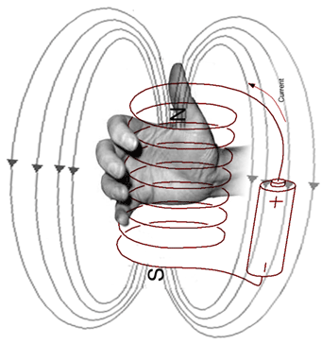
Right Hand Rule
If you wrap your fingers around the coil in the direction of the current, your thumb points north.

Slide 6
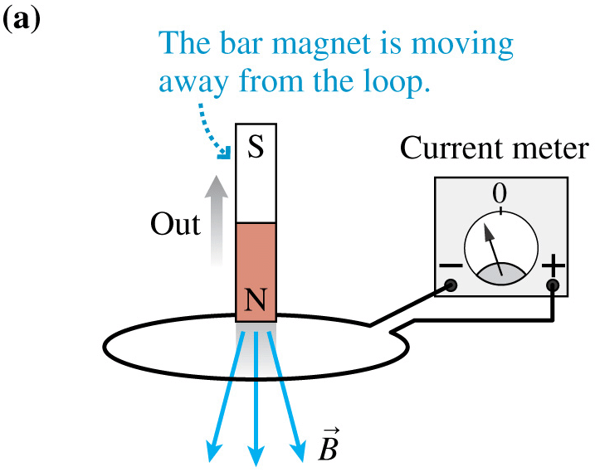
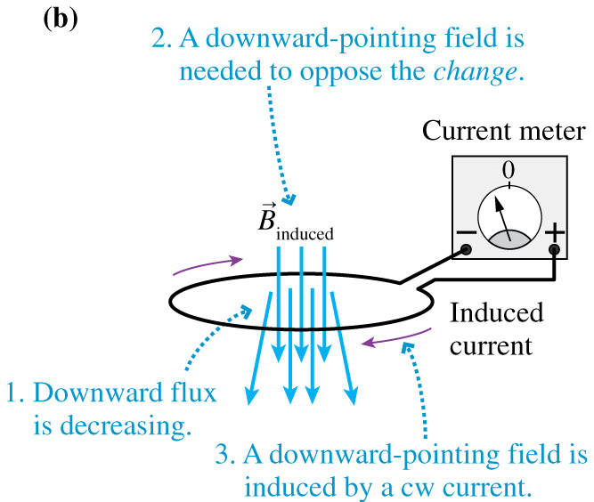
If the field of the bar magnet is already in the loop and the magnet is removed, the induced current is in the direction that tries to keep the field constant

Slide 7
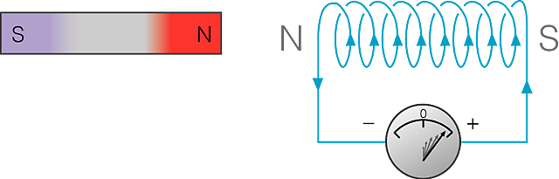
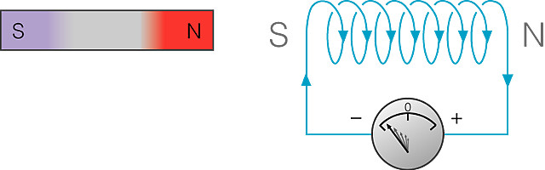

2 Direction of induced current
b Lenz's law
In both cases, magnet moves against a force.
Work is done during the motion & it is transferred as electrical energy.
Induced I always flows to oppose the movement which started it.

Slide 8
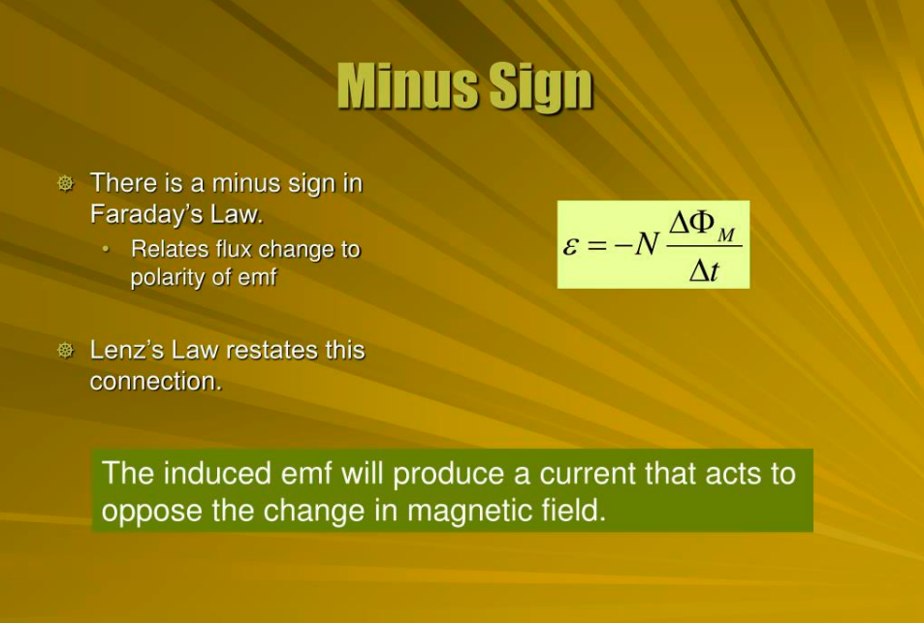

Slide 9
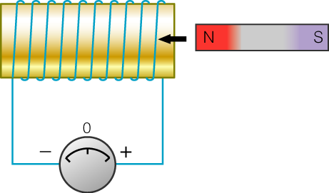
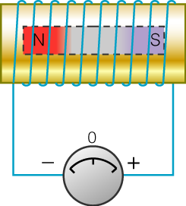
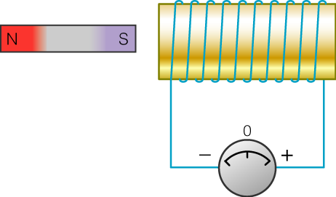
Example 1
Current induced along a coil
A bar magnet passes through a coil:
(i)
(ii)
(iii)
(a) Indicate the direction of the induced I in each case. Explain briefly.

Slide 10
Example 1
Current induced along a coil
(a) Indicate the direction of the induced I. Explain.
S
N
When magnet’s N-pole is moving into coil,
I
(i)
induced I flows in such a direction as to produce a N-pole
Lenz’s law
to oppose the approaching of magnet.

Slide 11
Example 1
Current induced along a coil
(a) Indicate the direction of the induced I. Explain.
(ii)
The induced I become zero
∴
I is about to change direction.

Slide 12
Example 1
Current induced along a coil
(a) Indicate the direction of the induced I. Explain.
S
N
I
(iii)
When magnet’s S-pole is leaving the coil,
induced I flows in such a direction as to
produce a N-pole to oppose the leaving of magnet.

Slide 13
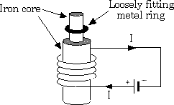
Lenz’s Law
Alternating current through the coil
What happens to Iron core?
What will happen to the ring?

Slide 14
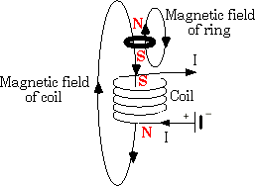
Lenz’s Law
The changing magnetic field in the coil due to the change in current induces a current in the metal ring. Lenz’s Law states that the magnetic field in the ring opposes the magnetic field of the coil and forces the ring to fly away.

Slide 15
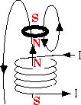
Lenz’s Law
What just happened?
How often does this occur?

Slide 16
Application of Lenz’s Law
Breaking Systems of train
AC Generator
Microphones
Motors
Transformer

Slide 17
Conclusion

